Slide 1
Algorithms
Lecture 1.2
Dr. Md Moniruzzaman

Slide 2
Reference Books
1. Introduction to Algorithms (Cormen, Leiserson, Rivest,and Stein)
2. Algorithms (Dasgupta, Papadimitriou, and Vazirani)
3. Algorithms (Erickson)

Slide 3
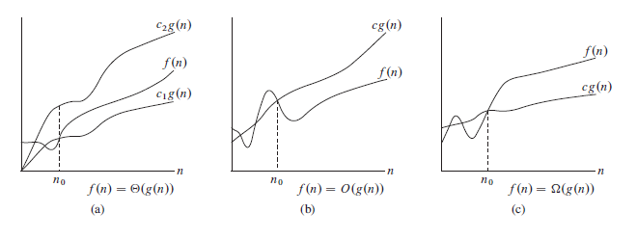
Complexity Analysis

Slide 4



Complexity Analysis

Slide 5
Sorting

Slide 6
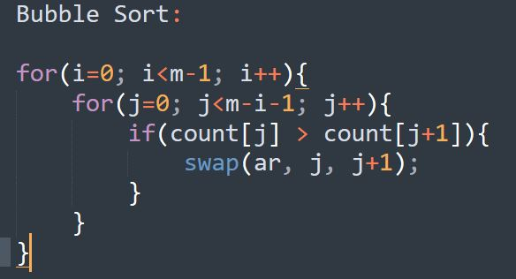
Bubble Sort

Slide 7
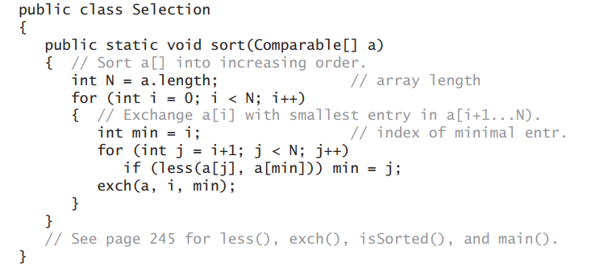
Selection Sort

Slide 8
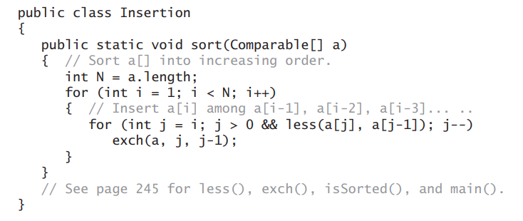
Insertion Sort:

Slide 9
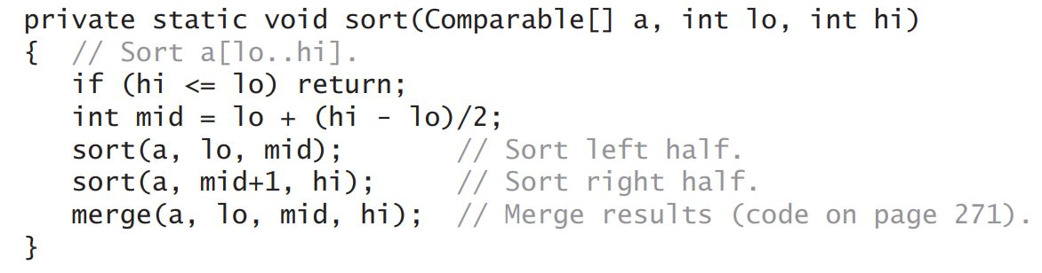
Merge Sort: (Sort Procedure)

Slide 10
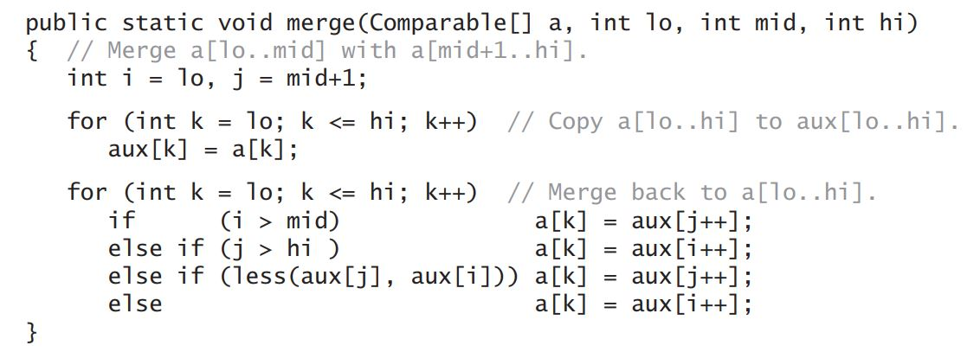
Merge Sort: (Merge Procedure)

Slide 11
Problems to solve using sorting:
UVA 612
Codeforces 984A

